Slide 1
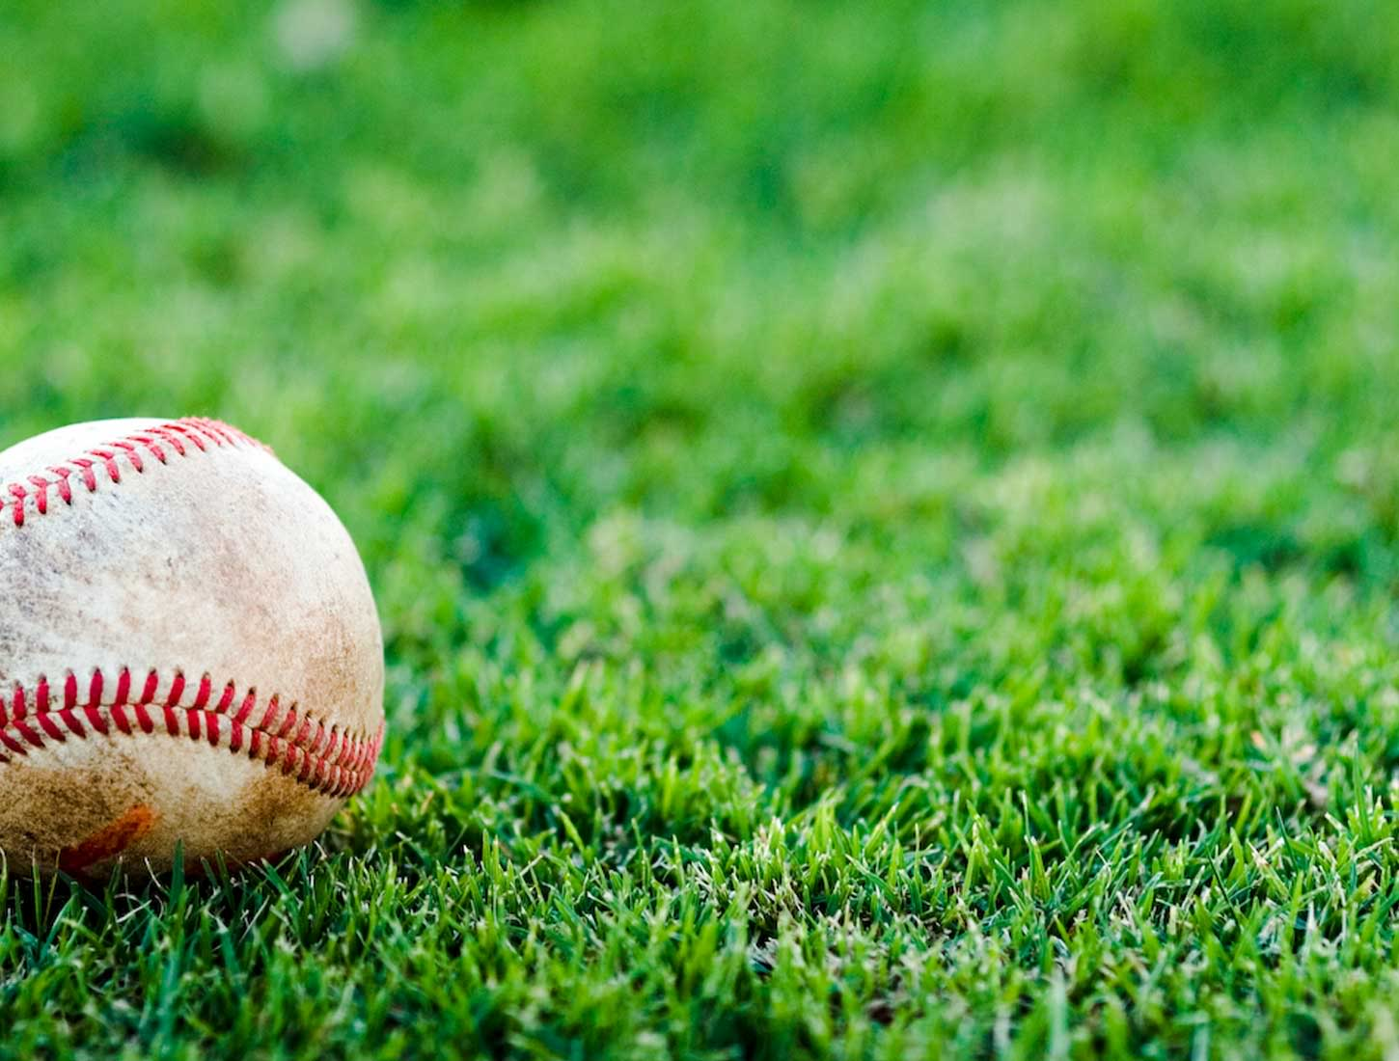
Predicting America’s Pastime...

Slide 2
Hypothesis:
Winners of late-season games can be predicted by using team performance to-date.
Data: MLB Game logs 1920-2015
Fields:
Teams
Dates
Results
Counting Stats
Lineups
Starting Pitchers
Umpires

Slide 3

Assumptions:
Team performance is idiosyncratic by year. A given team in one year is different than that same team the next year.
The game evolves. What worked in 1920 may not work in 2015.
Baseball requires large sample sizes to adequately measure performance.

Slide 4
Data Considerations:
Data is chronological and needs to remain in order.
Data needs to be standardized as late-season totals will always be greater than earlier-season.
Statistical rankings are incredibly volatile early in the season.

Slide 5
Data Manipulations:
For each date, of each season, for each team, calculate team’s cumulative statistical performance.
To standardize, for each of the previous data points, rank each team against their peers.
Divide each season into a skipped, a training, and a testing data set.
Skip (20%)
Train (60%)
Test (20%)

Slide 6
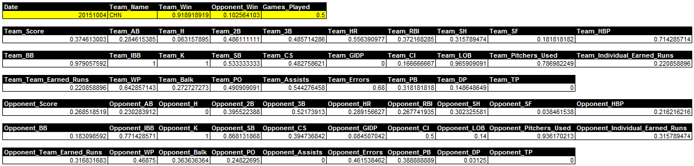
On Any Given Day:

Slide 7
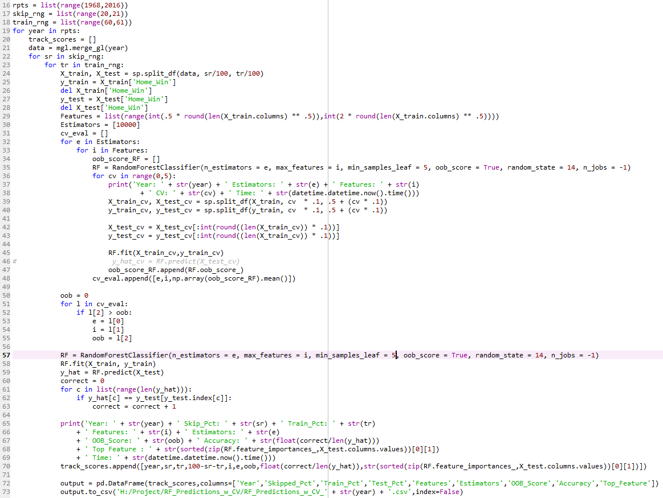
Strike 1: Random Forest

Slide 8
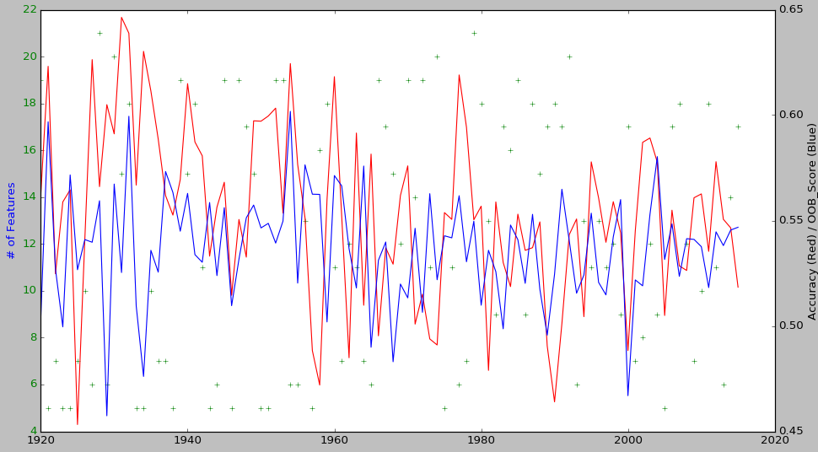
Random Forest Results

Slide 9
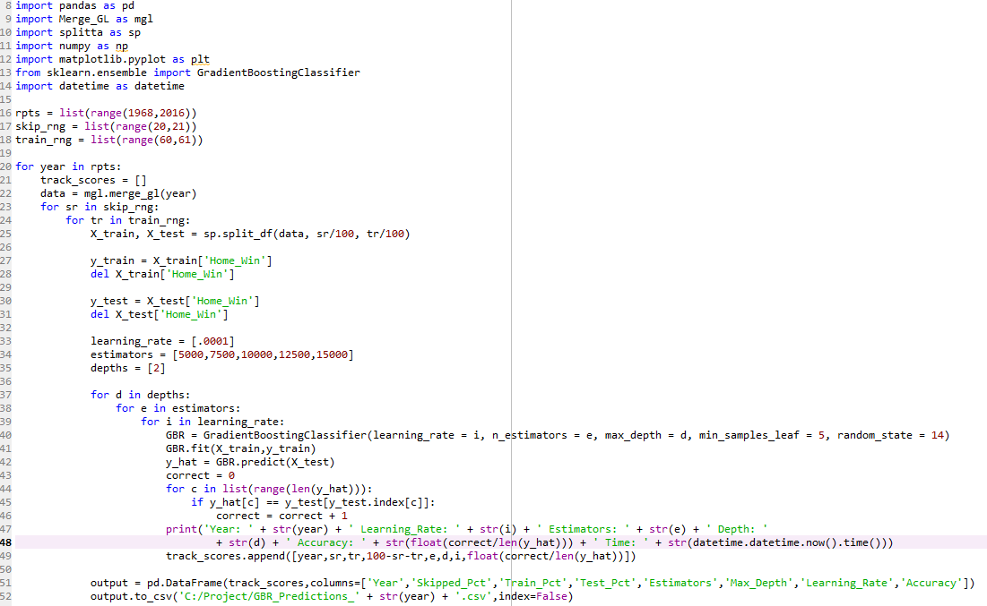
Strike 2: Boosting

Slide 10
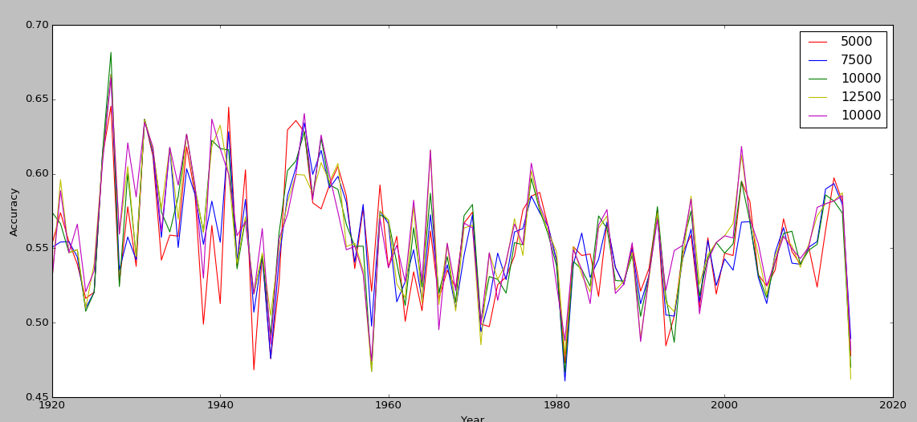
Boosting Results

Slide 11
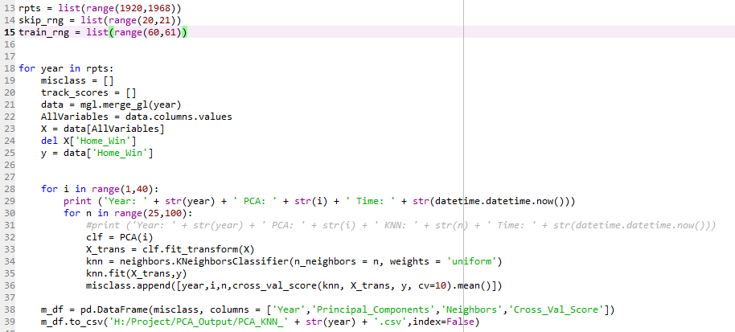
Strike 3!!!!: PCA & KNN

Slide 12
PCA & KNN Results

Slide 13
Conclusions
Detailed player, lineup, team-specific, weather, and umpire data could improve this model dramatically.
Momentum? Use rolling performance?
Large volatility in accuracy of data model through time, which seems to be decreasing.
Predictions mean little in a vacuum. Confidence in predictions has to relate to betting odds/money lines.

